Slide 1
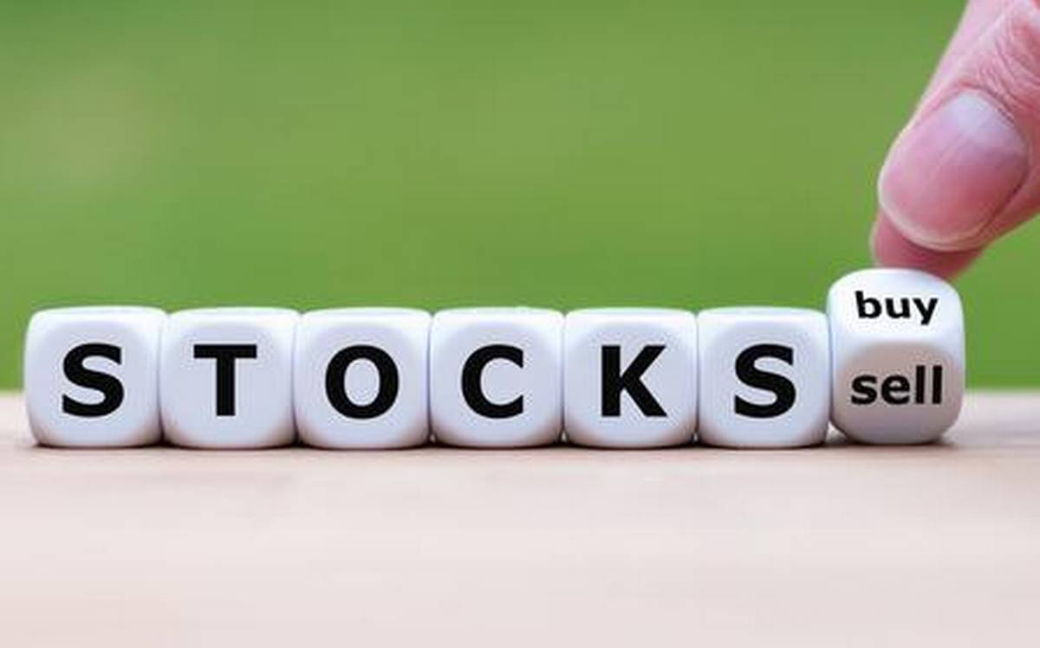

Final Year Project on Stock Market prediction using Machine Learning
Guru Nanak Institute of Technology
Computer Science Department

Slide 2


Project mentor: Pallabi Das Assistant professor, CSE Department, GNIT,Sodepur
Team Members:
1. Rima Panja
2. Rittika Chakraborty
3. Swarnadipa Chakraborty
4. Biprojit Chakraboty
5. Rumon Mukherjee

Slide 3

Presentation Flow:
INTRODUCTION
Why prediction is important?
Technology used
Dataset description
Algorithm used
Experimental Outcome
Conclusion
Future Scope
Reference

Slide 4

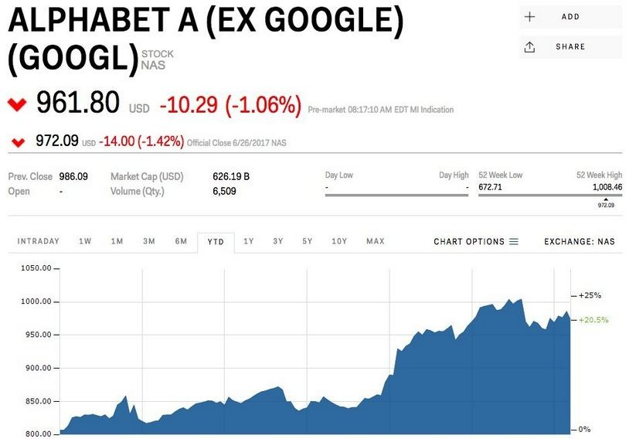
INTRODUCTION
A stock market is a public market for the trading of company stock.
Stock market allows us to buy and sell units of stocks (ownership) of a company.
If the company’s profits go up,then we own some of the profits and if they go down, then we lose profits with them.
●
If | more | sellers |  | than | buyers, stock
prices tend to fall. Conversely, when
more buyers than sellers, stock prices
tend to rise

Slide 5
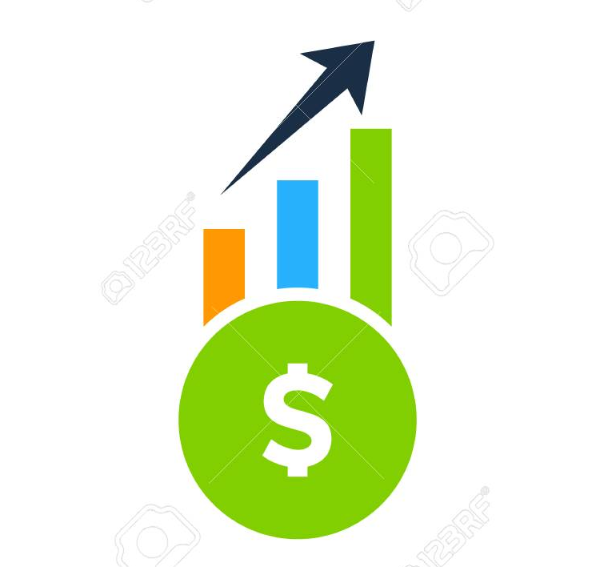
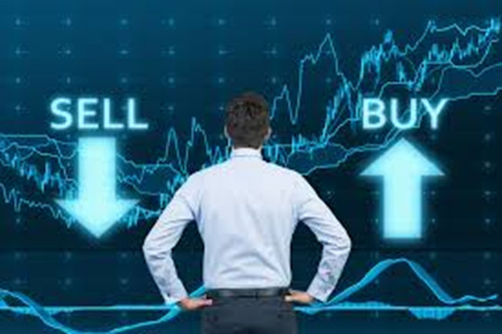

Why prediction is important?
People who are investing in stock may not have time to go through each and every stock. If someone predicts about suitable stocks. If someone predicts about suitable stocks, it will be helpful to investors. They may choose the stocks invest very easily.

Slide 6





Technology used:

Slide 7
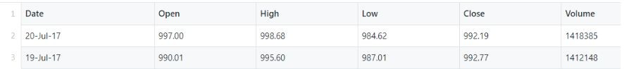
Dataset Description:
Date- day on which the stock is traded
High- high is the highest price at which a stock traded during the course of the day
Close- refers to the last price at which a stock trades during a regular trading session
Open- price of the
first trade for any listed stock is its daily opening price.
Low- lowest price at which a stock trades over the course of a trading day.
Volume- the number
of shares or contracts traded in a security or an entire market during a given period of time

Slide 8


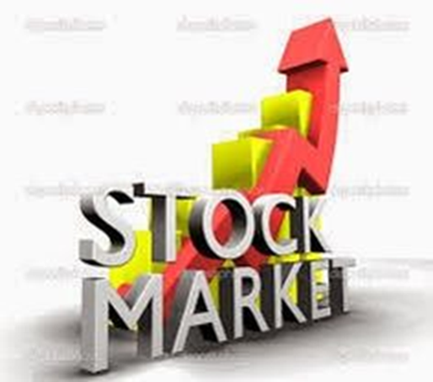
Used:
Linear Regression
Decision Tree
LSTM

Slide 9
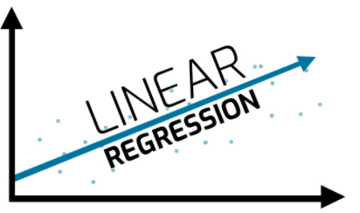
Linear Regression Algorithm
Regression is a method of modelling a target value based on independent predictors. This method is mostly used for forecasting and finding out cause and effect relationship between variables. Regression techniques mostly differ based on the number of independent variables and the type of relationship between the independent and dependent variables.

Slide 10
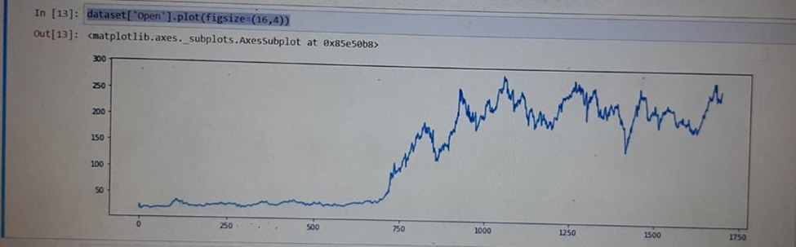
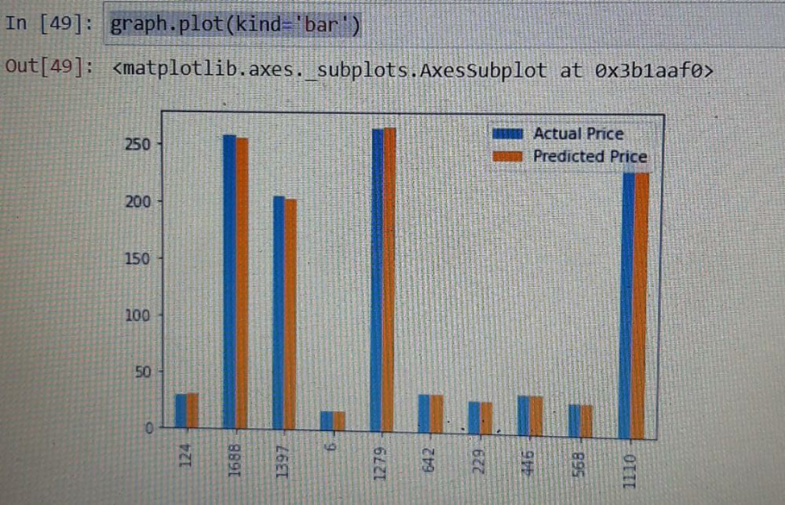
Experimental Outcome
Graph to represent the open price stock in a year
Graph to represent the actual price and predicted price.

Slide 11

Decision Trees
Decision Trees are a type of Supervised Machine Learning (that is you explain what the input is and what the corresponding output is in the training data) where the data is continuously split according to a certain parameter. The tree can be explained by two entities, namely decision nodes and leaves. The leaves are the decisions or the final outcomes. And the decision nodes are where the data is split.

Slide 12
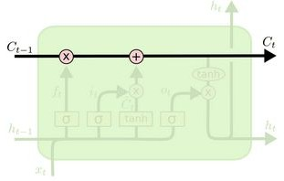
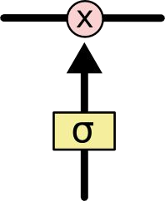

LSTM
LSTM (How it works?)
The key to LSTM is the Memory cell state which stores the information. It runs straight down the entire chain.
LSTM has the ability to remove or add information to these cell state, regulated by structures called gates.
Gates are composed of sigmoid neural net layer and a multiplication operation.
Sigmoid layer outputs zero or one.
Multiplication operation
Sigmoid layer

Slide 13
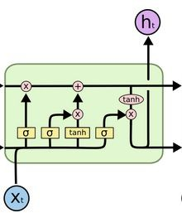
LSTM
LSTM (How it works?)
There are three gates to protect and
control the cell states.
Input gate
Output gate
forget gate
input gate
output gate
forget gate

Slide 14
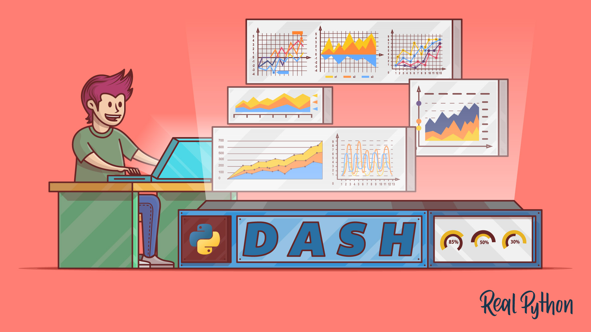

Problem Statement & Website creation
Prediction of stock price using LSTM on a company’s dataset.
Prediction of stock price from another companies’ datasets using the last saved LSTM model.
Building a dashboard in a website for stock analysis using Flask and Dash frameworks.

Slide 15
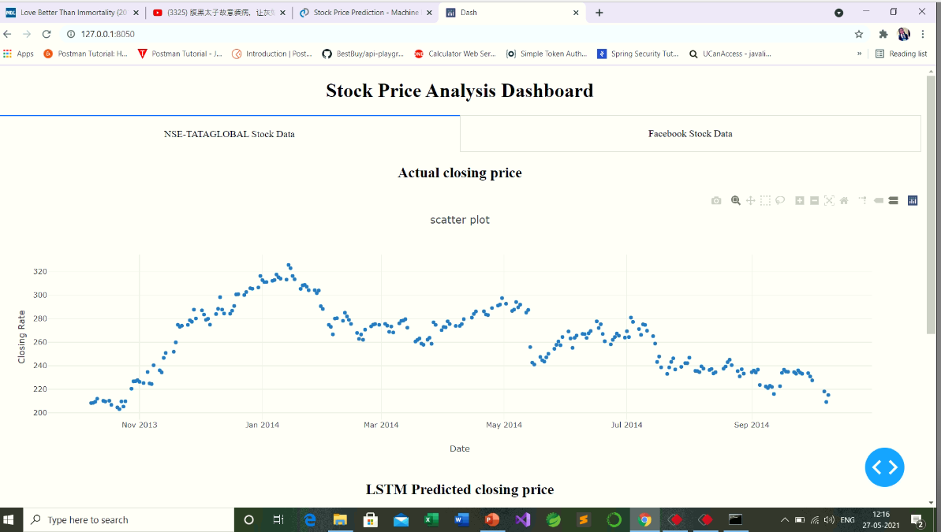

Slide 16
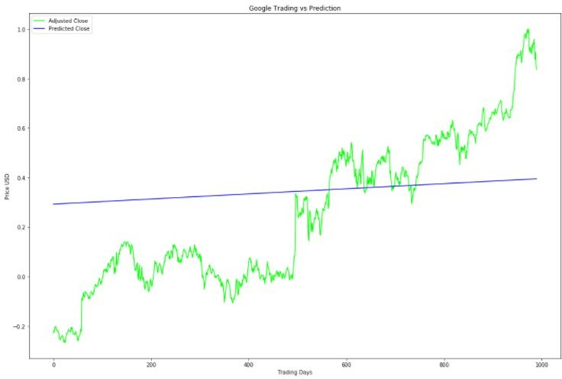
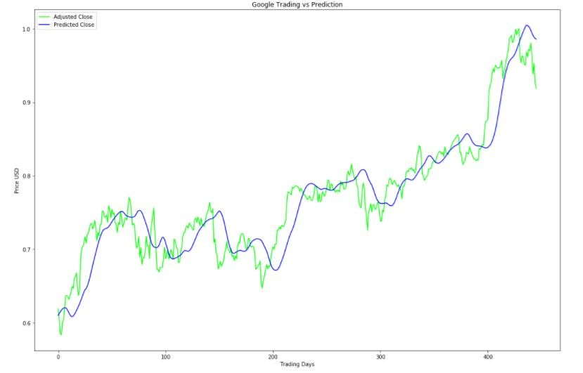
CONCLUSION
Linear Regression
Model does not fit properly
Stock price prediction is a complex problem and difficult to predict.
Machine learning model doesn’t perform well as compared to Deep Learning model.
LSTM
Model fits properly

Slide 17


In our project, we have worked on the dataset of tesla stock price up to certain year range. We will try our best to add new features like by increasing the range, so that it can be easily implemented under various situations, and also to increase more flexibility in all the modules. Moreover, our future aim is to create software along with a website that will analyse previous stock data of certain companies, with help of certain parameters that affect stock value. We are going to implement these values in data mining algorithms to predict more accurate result. This will also help us to determine the values that particular stock will have in near future. We will determine the Month’s High and Low with help of data mining algorithms.

Slide 18


en.wikipedia.org
tutorialpoint.com
Ajith, A., Baikunth, N. &Mahanti, P. K. (2003a). Hybrid intelligent systems for stock
market analysis. In Proceedings of International Conference on Computational Science.
towardsdatascience.com
https://www.analyticsvidhya.com

Slide 19




For staying with us…

Slide 21
A stock (also known as equity) is a security that represents the ownership of a fraction of a corporation. This entitles the owner of the stock to a proportion of the corporation's assets and profits equal to how much stock they own. Units of stock are called "shares."
The concept behind how the stock market works is pretty simple. Operating much like an auction house, the stock market enables buyers and sellers to negotiate prices and make trades. Investors can then buy and sell these stocks among themselves, and the exchange tracks the supply and demand of each listed stock.

Slide 22



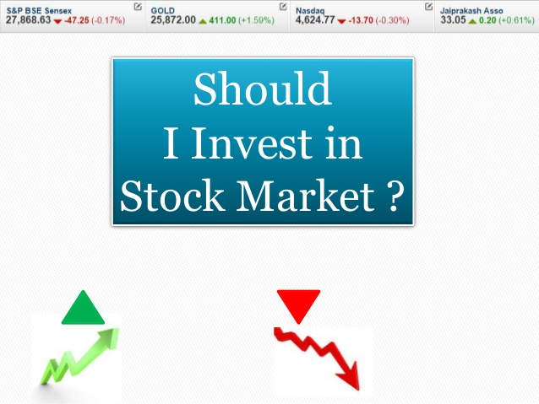
→To Grow Money
→for the Power of Compounding
→It provides More Than Other Investments
→to gain Profit from Industries

Slide 23

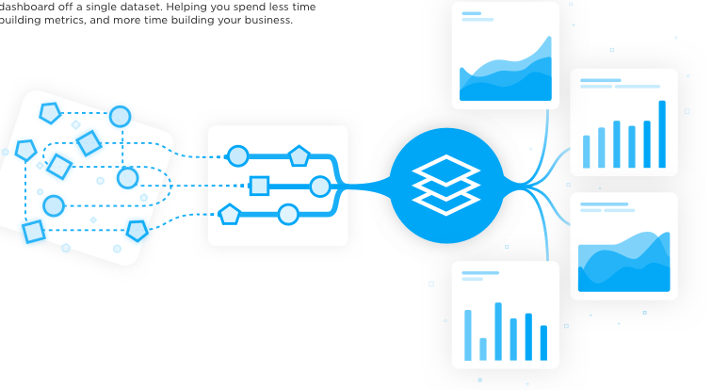
Dataset Description
Within the dataset one will encounter the following:
1.The date - "Date"
2.The opening price of the stock - "Open"
3.The high price of that day - "High"
4.The low price of that day - "Low"
5.The closed price of that day - "Close"
6.The amount of stocks traded during that day - "Volume"
The stock's closing price that has been amended to include any distributions/corporate actions that occurs before next days open - "Adj[usted] Close"
http://www.kaggle.com

Slide 24


What is Stock Market??
The concept behind how the stock market works is pretty simple. Operating much like an auction house, the stock market enables buyers and sellers to negotiate prices and make trades. Investors can then buy and sell these stocks among themselves, and the exchange tracks the supply and demand of each listed stock.

Slide 25

What is stock??
→A stock (also known as equity) is a security that represents the ownership of a fraction of a corporation. This entitles the owner of the stock to a proportion of the corporation's assets and profits equal to how much stock they own. Units of stock are called "shares."

